Slide 1
Visual Audit Exploratory Data Analysis: Framework and Demonstration
Lu Zhang, Qi Liu and Heejae Lee

Slide 2
Introduction
Using Exploratory Data Analysis with interactive data visualization can help auditors unearth hidden patterns and exceptions. This feature enables auditors go beyond the existing audit objectives and find new risk indicators.
However, there are only few studies that examine how interactive visualization should be applied in accounting, especially in auditing.
Examine how interactive visualization can be used in auditing and suggest novel framework for visual audit.
Demonstrate six visual audits using a large hospital database.

Slide 3
Visual Audit Triangle
3 Components
6 Flows
9 Sub-components
  2 sub-objectives
  2 sample features
  5 graph designs

Slide 4
Zoom – In Approach for Interaction

Slide 5
Visual Audit Documentation
Customized Visual Audit Process Models
Visual Audit Automation
Standardized Visual Audit Reports
Visual Financial Statements

Slide 6
Data
Data from 45 hospitals
Select client 11 as a target and perform visual audit
  Midsize hospital (Transaction volume, Number of Accounts)
  High proportion of Bad Debt
Use transactions from 2014 Jan to 2017 Apr for the analysis
  Data integrity issue for previous year data
Total 6,093,847 transactions record for client 11

Slide 7
Visual Audit Demonstration
Visual Audit 1: Business Understanding
Visual Audit 2: Revenue Analysis
Visual Audit 3: Transaction Analysis
Visual Audit 4: Receivable Analysis
Visual Audit 5: Internal Control Test
Visual Audit 6: Analytical Procedure

Slide 8
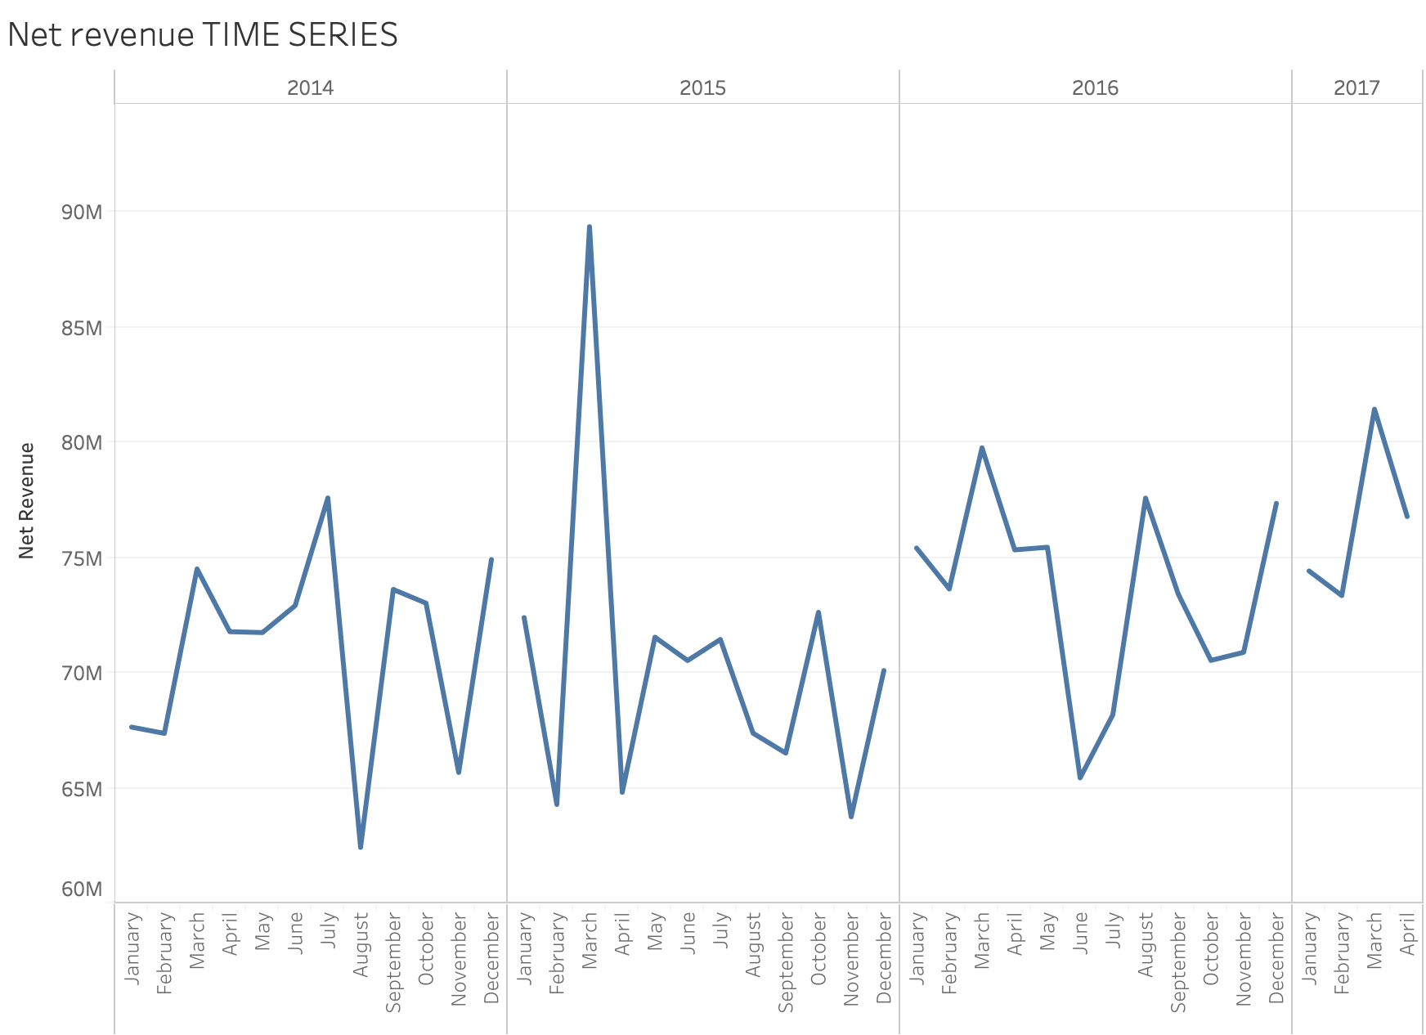
Monthly Revenue Analysis (Fig 1)

Slide 9
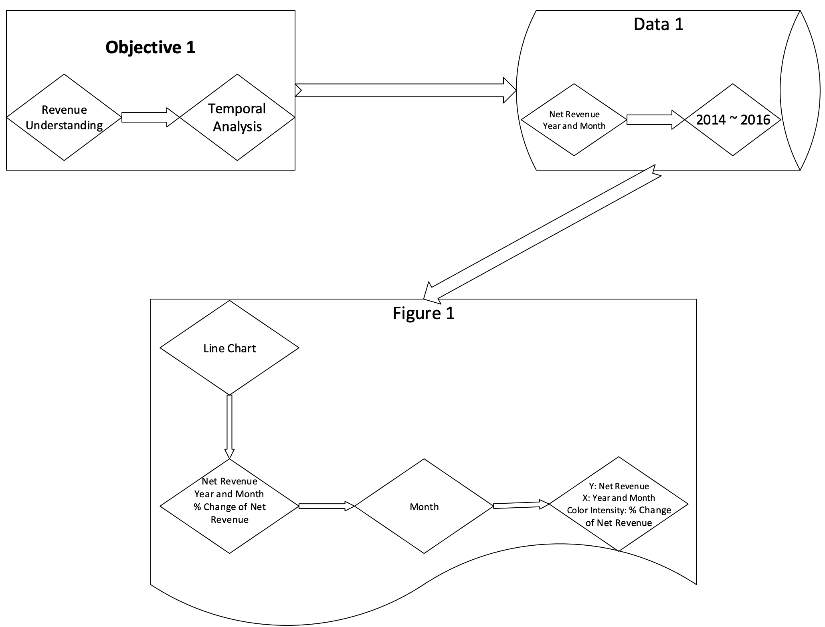
Customized Visual Audit Process Model

Slide 10
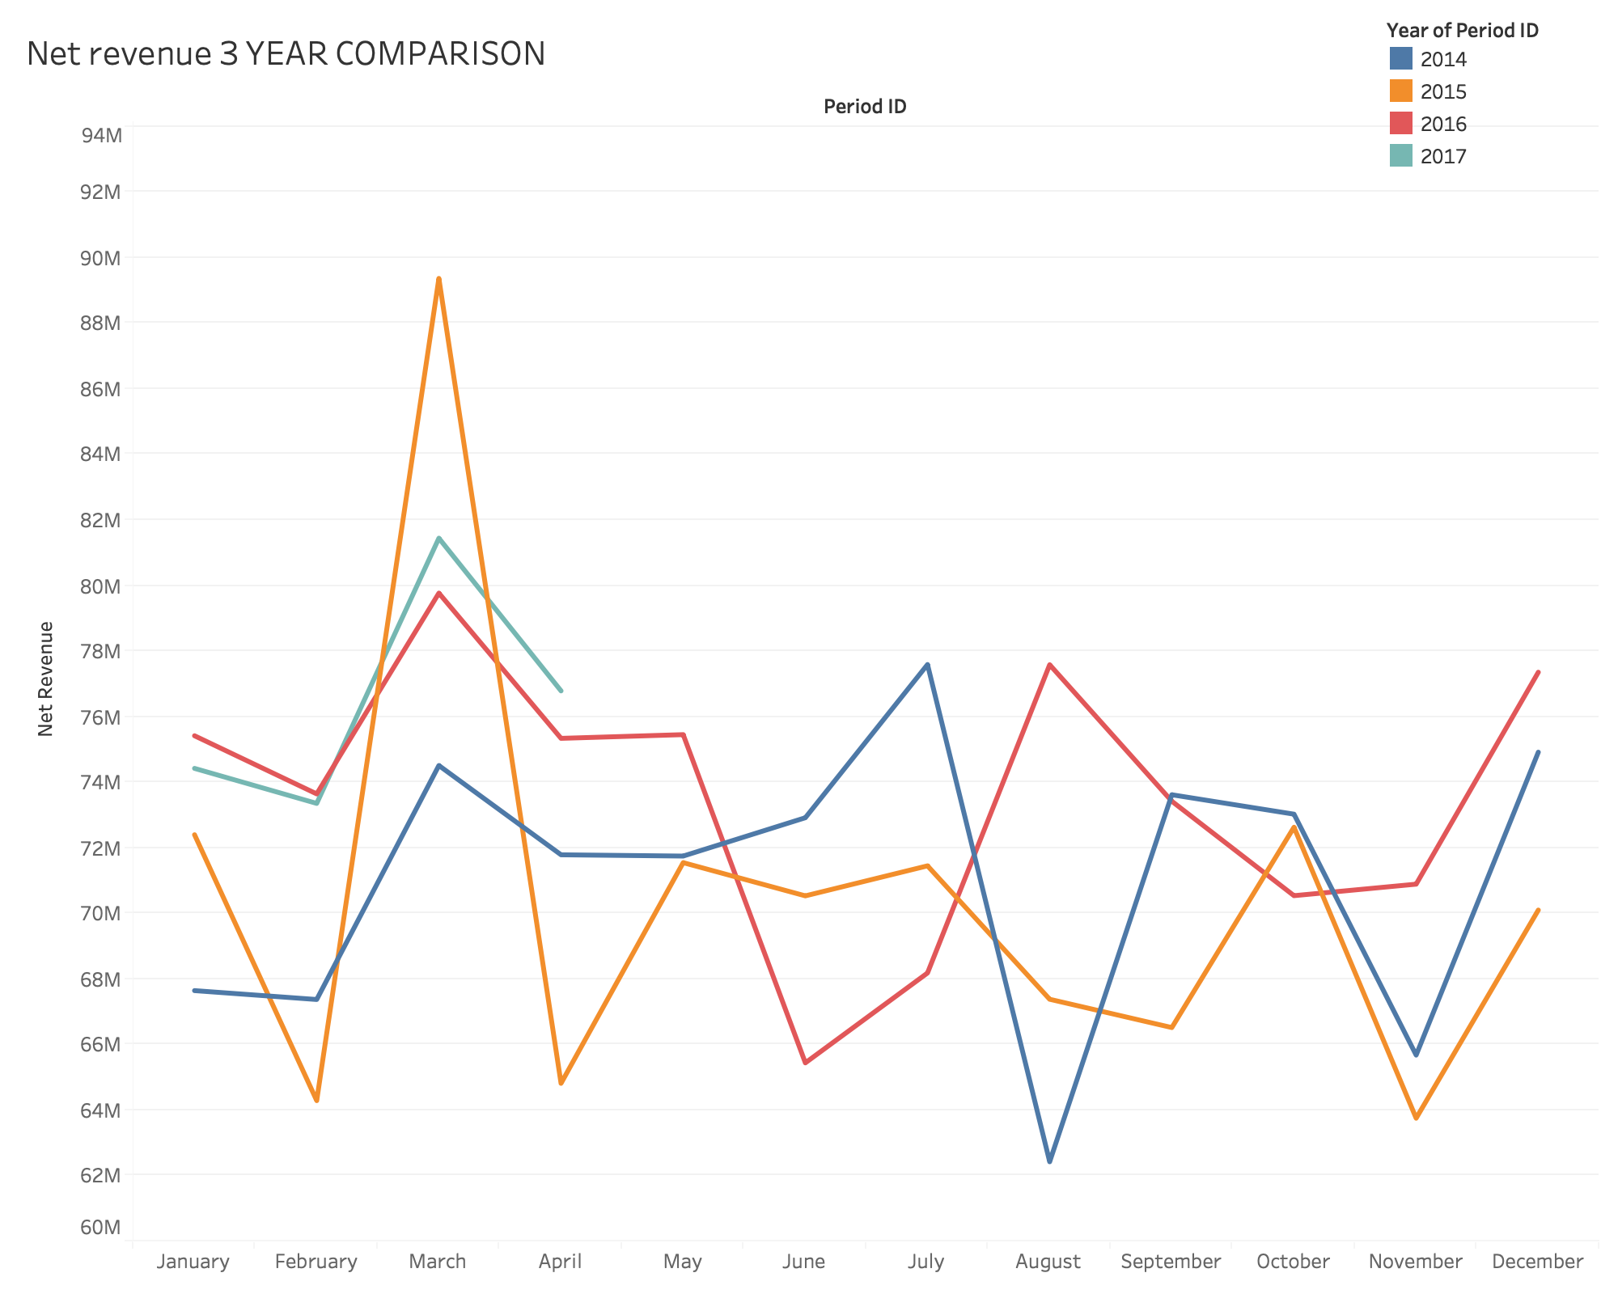
Monthly Revenue Seasonal Analysis (Fig 2)

Slide 11
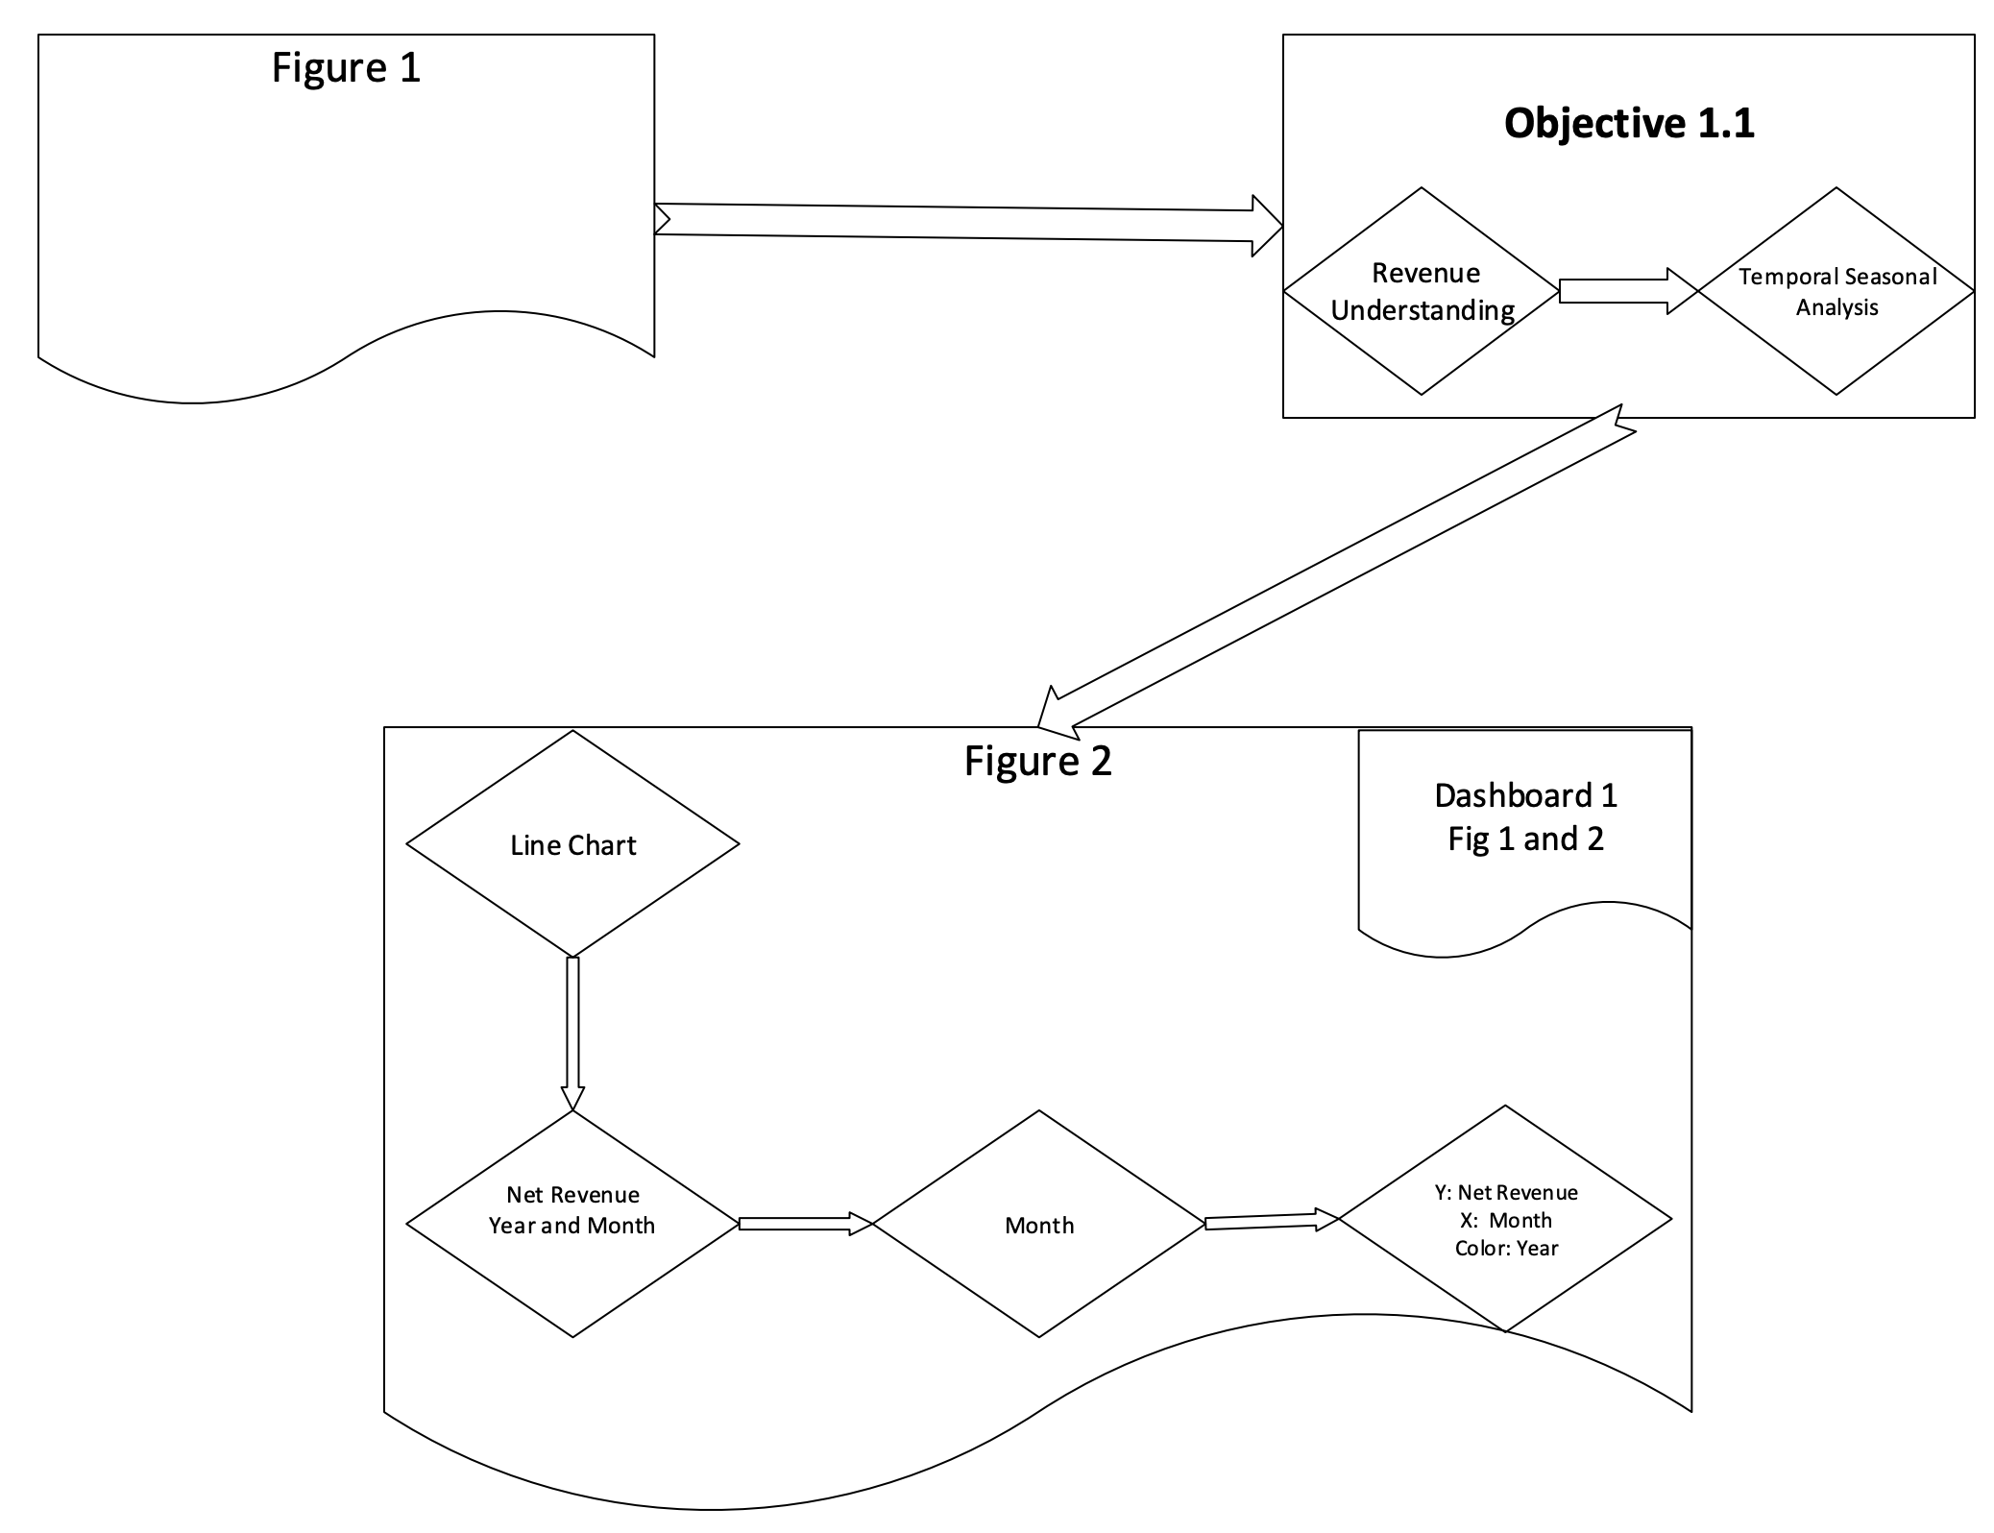
Customized Visual Audit Process Model

Slide 12
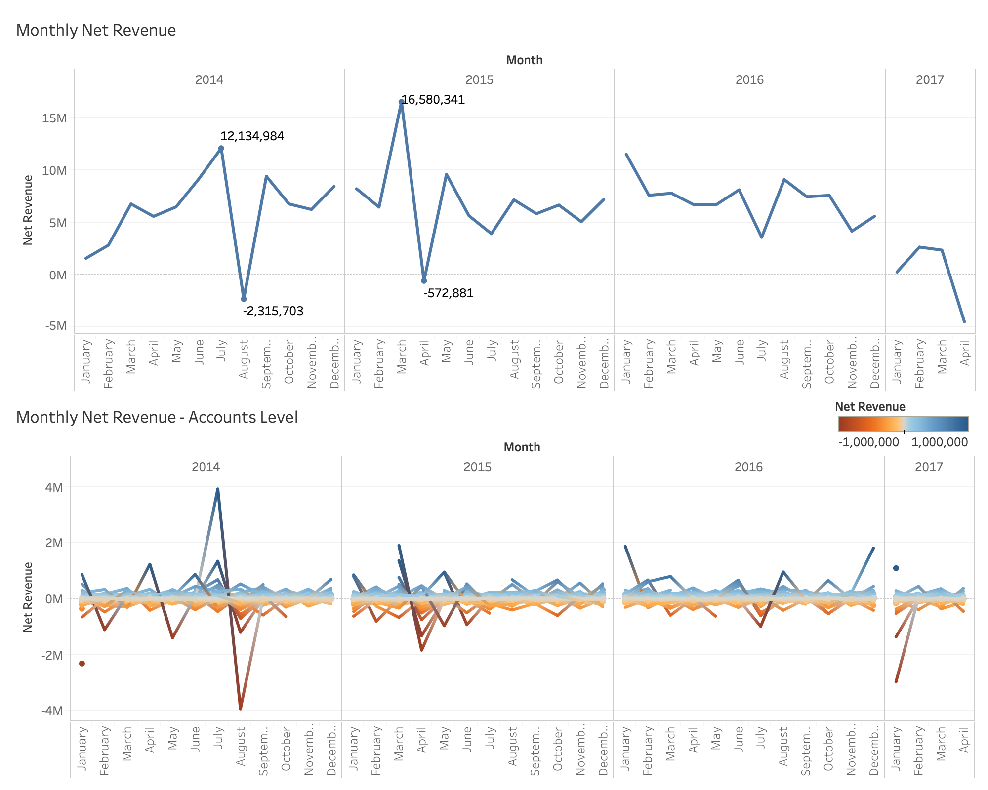
Monthly Revenue Analysis on Exceptional Revenue Adjustment Accounts
Dashboard 1 with fig 3 and fig 4

Slide 13
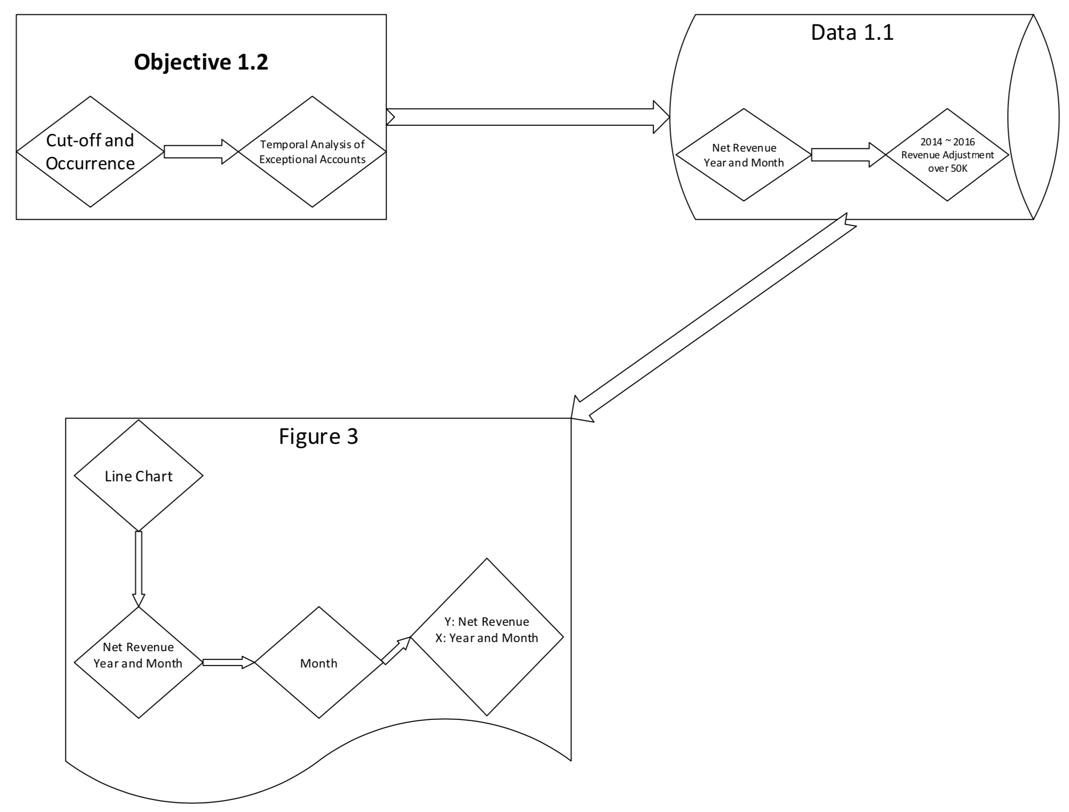
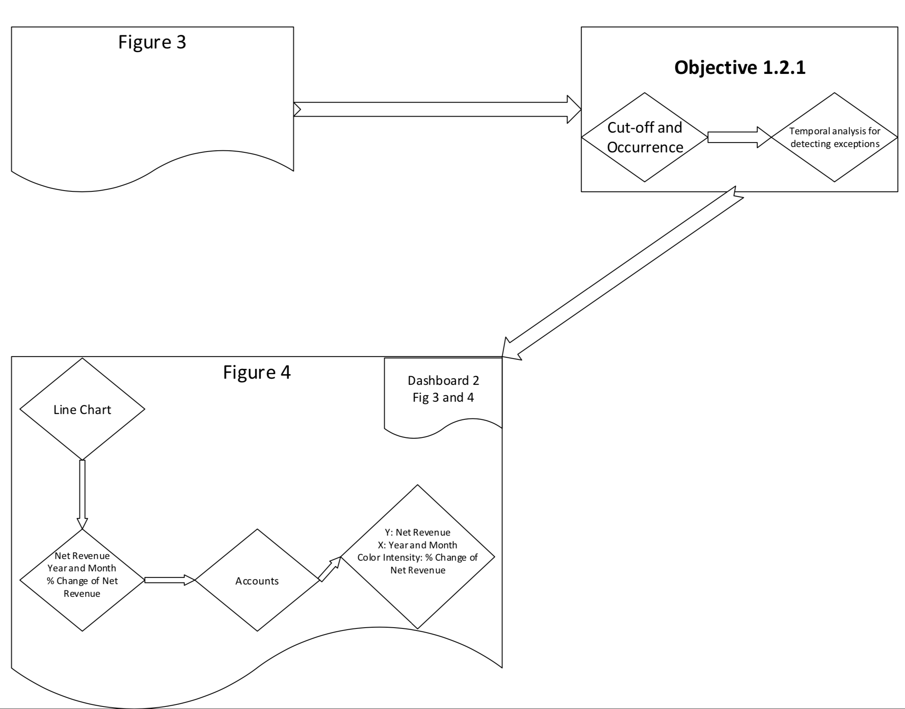
Customized Visual Audit Process Model

Slide 14
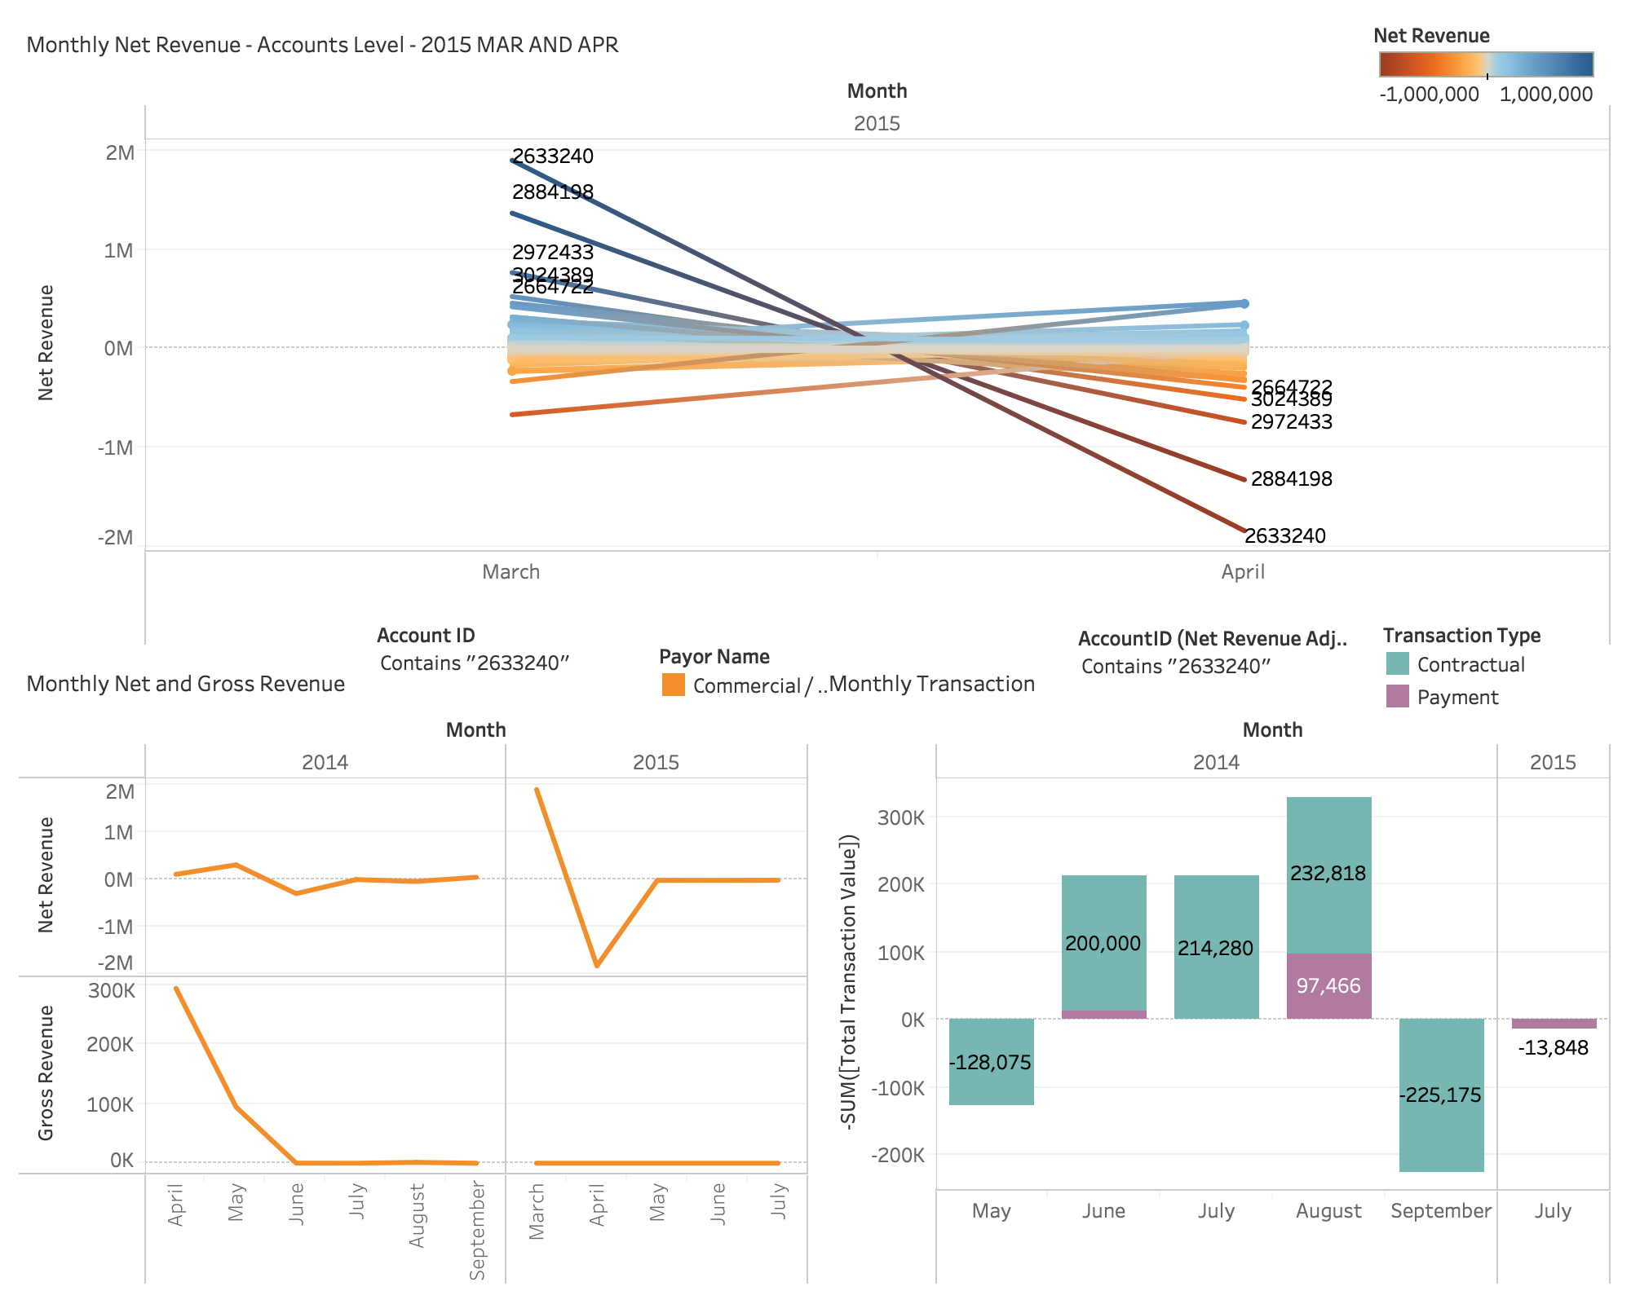
Analyze Exceptions using Dashboard
Dashboard including fig 5

Slide 15
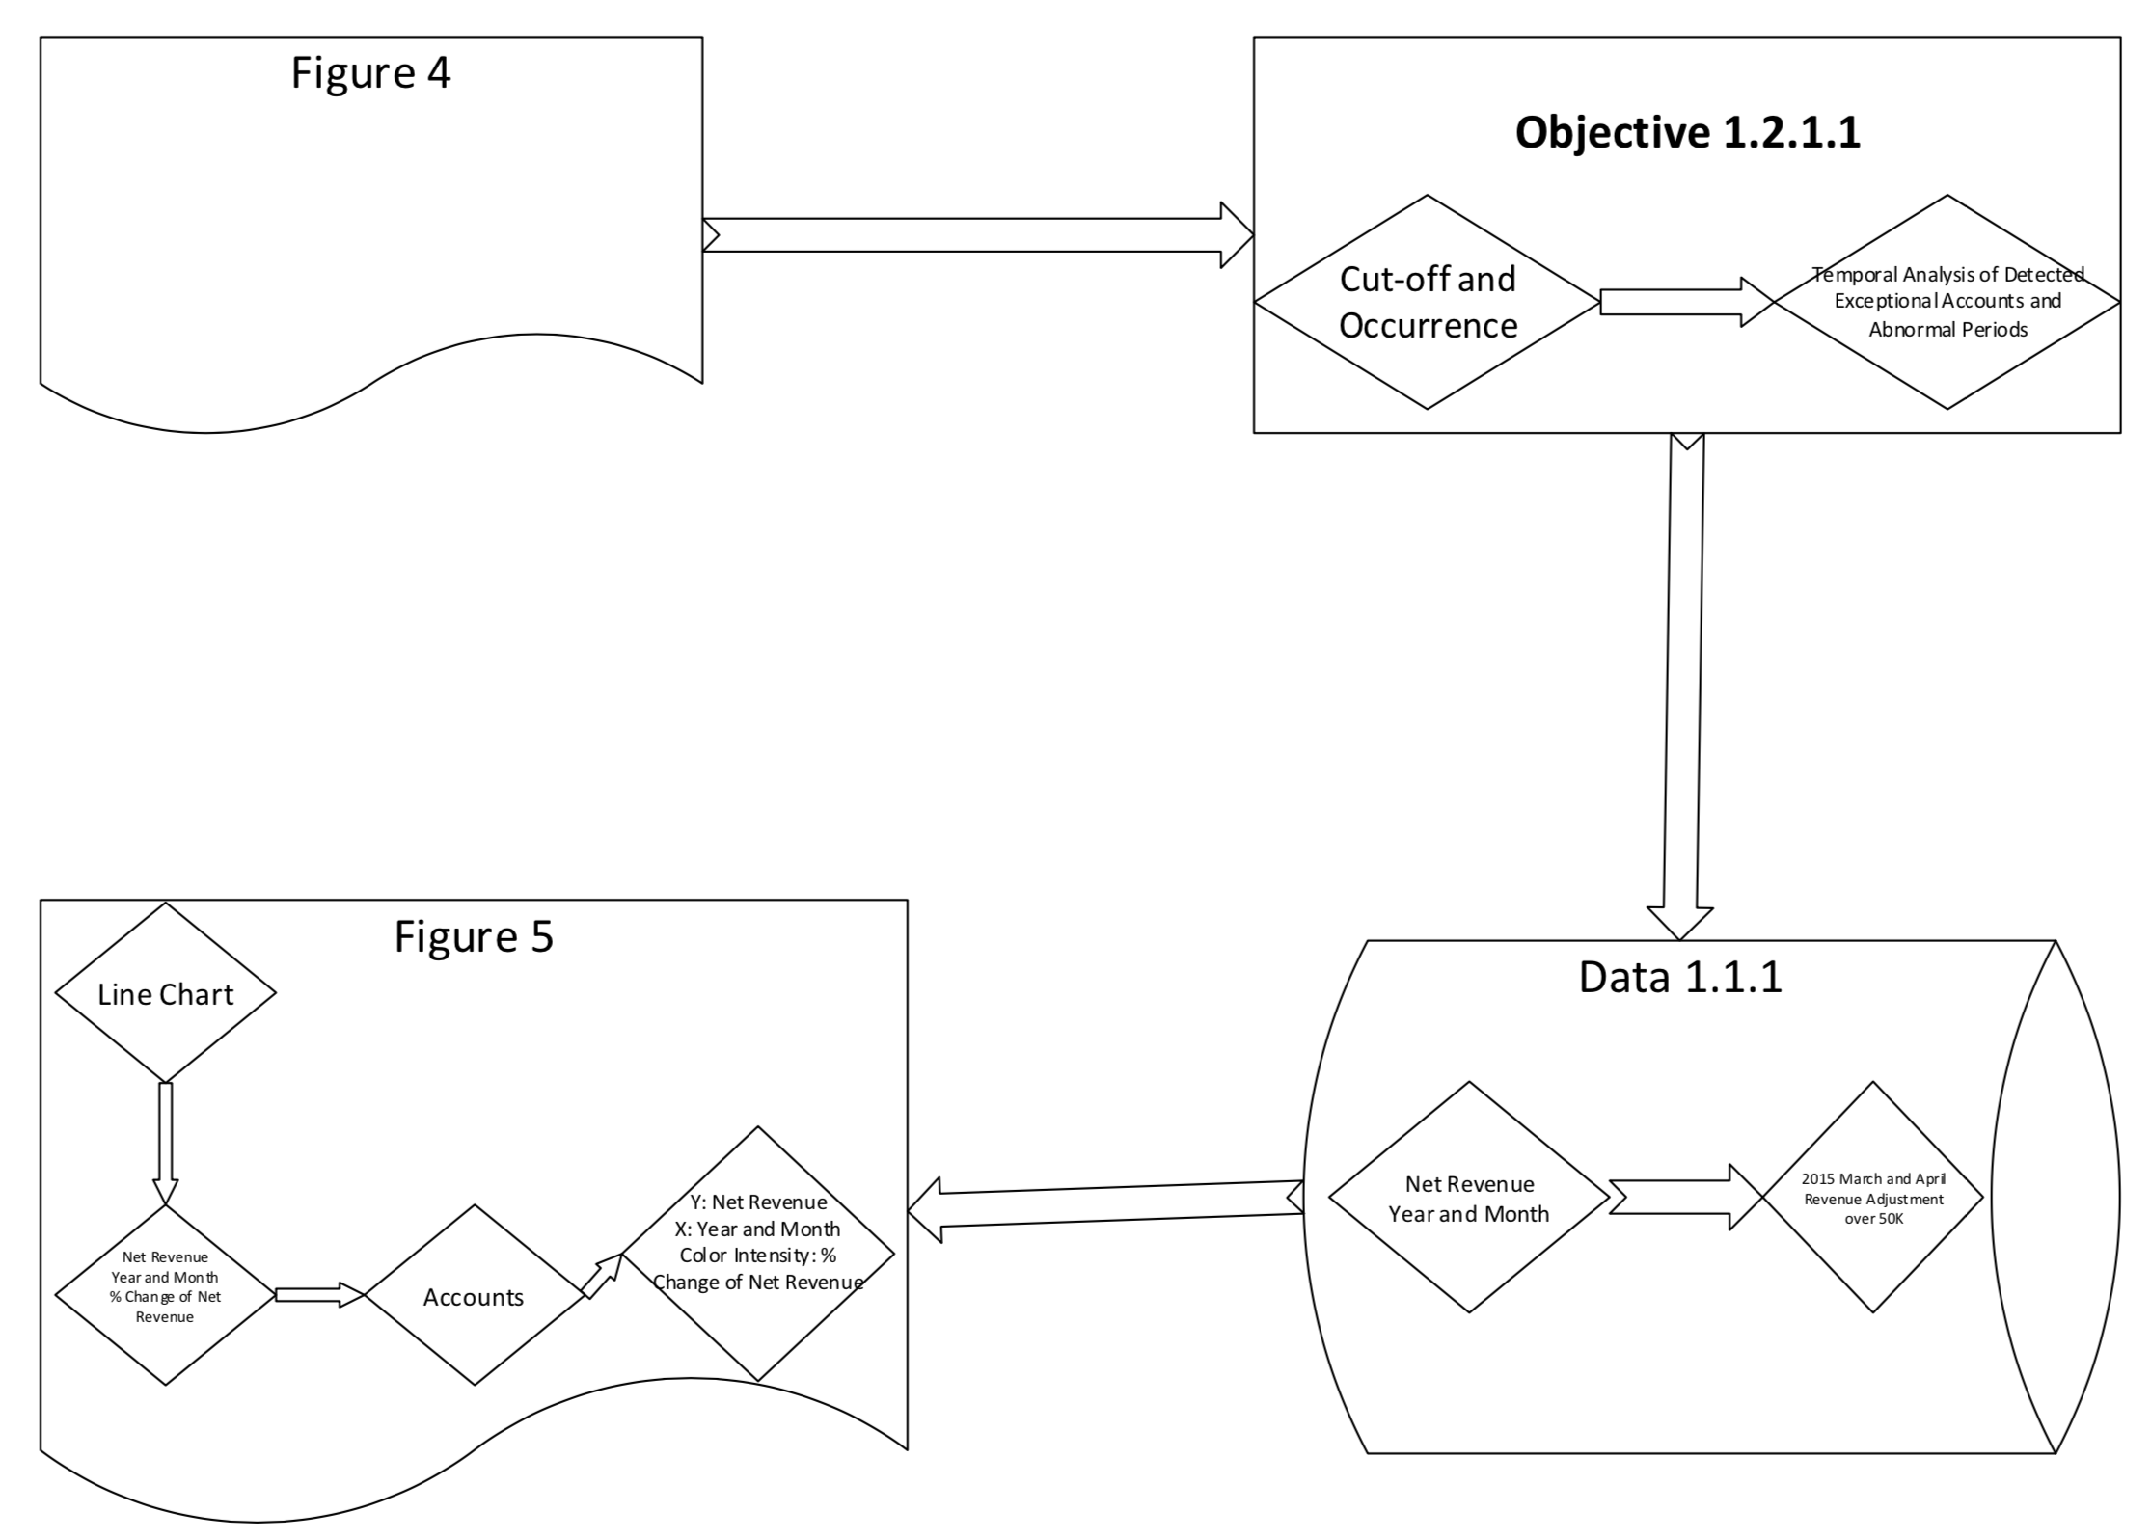
Customized Visual Audit Process Model

Slide 16
Thank you!!!
Questions?

